Slide 1

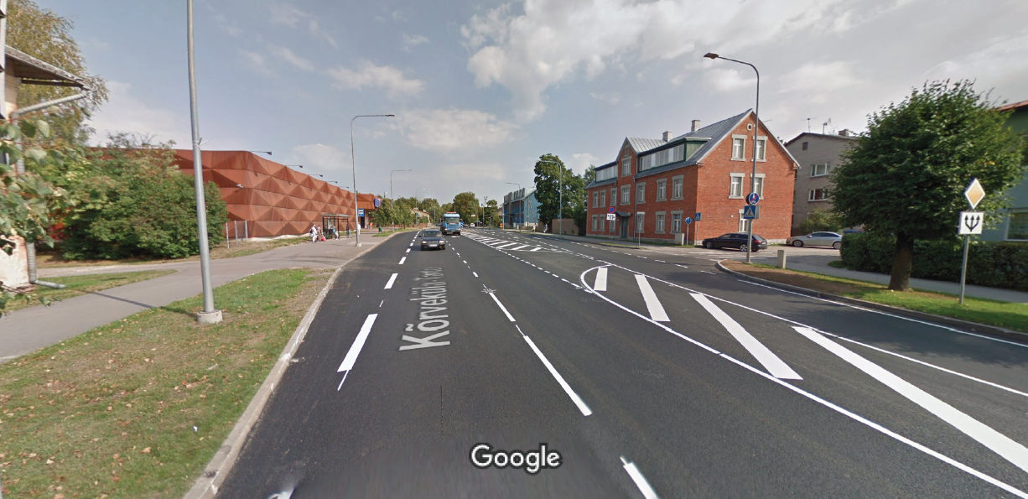
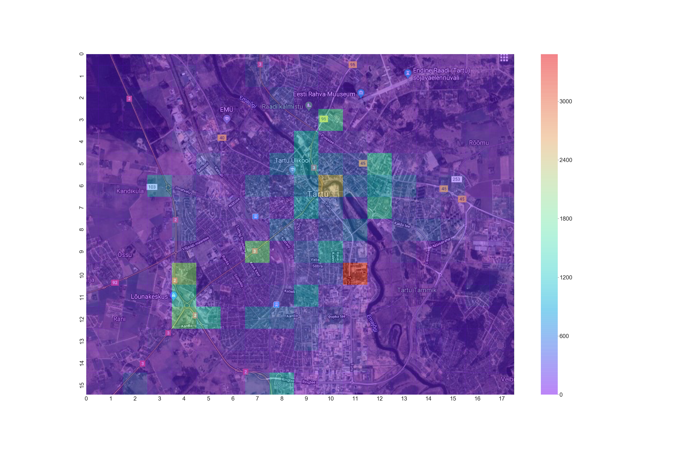
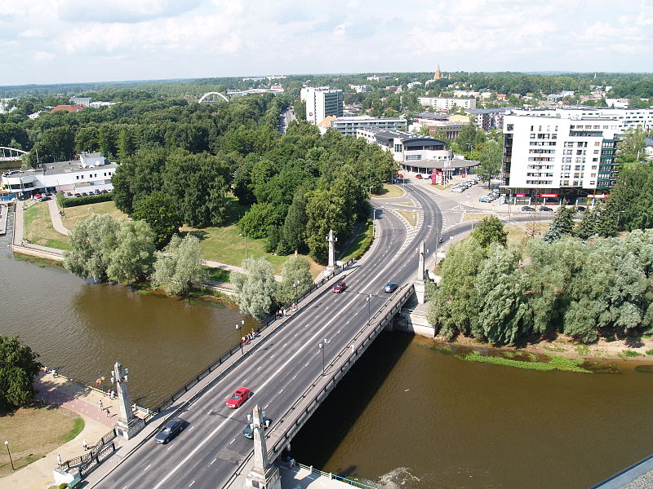
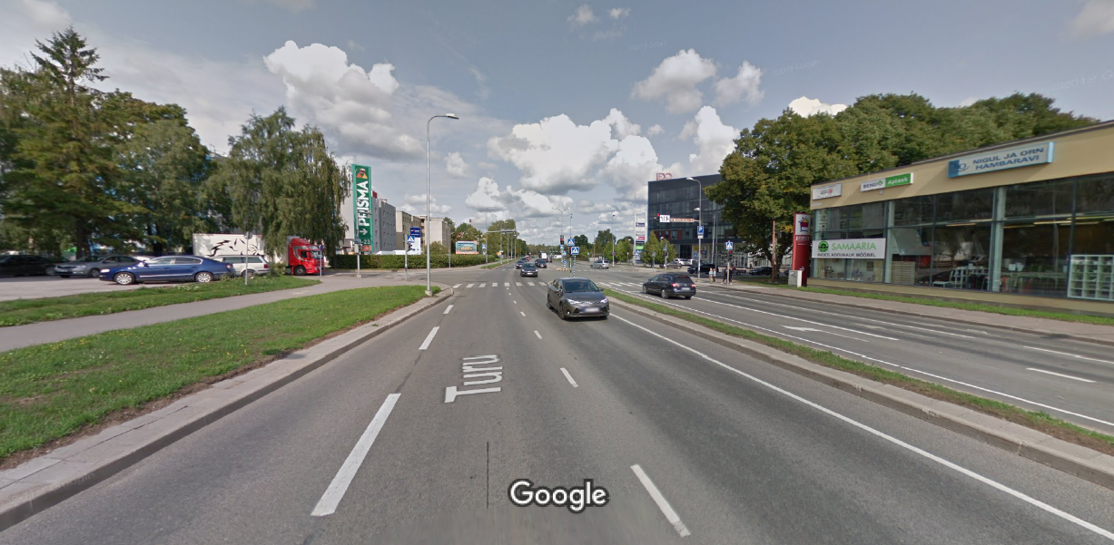
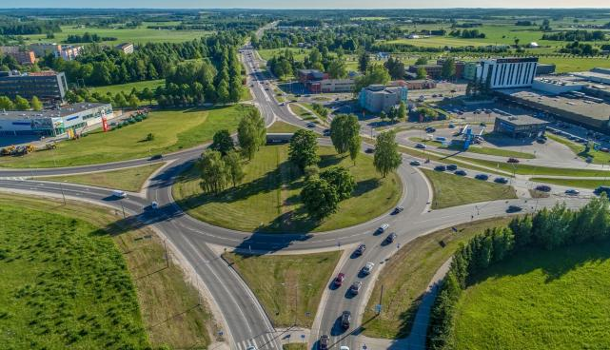
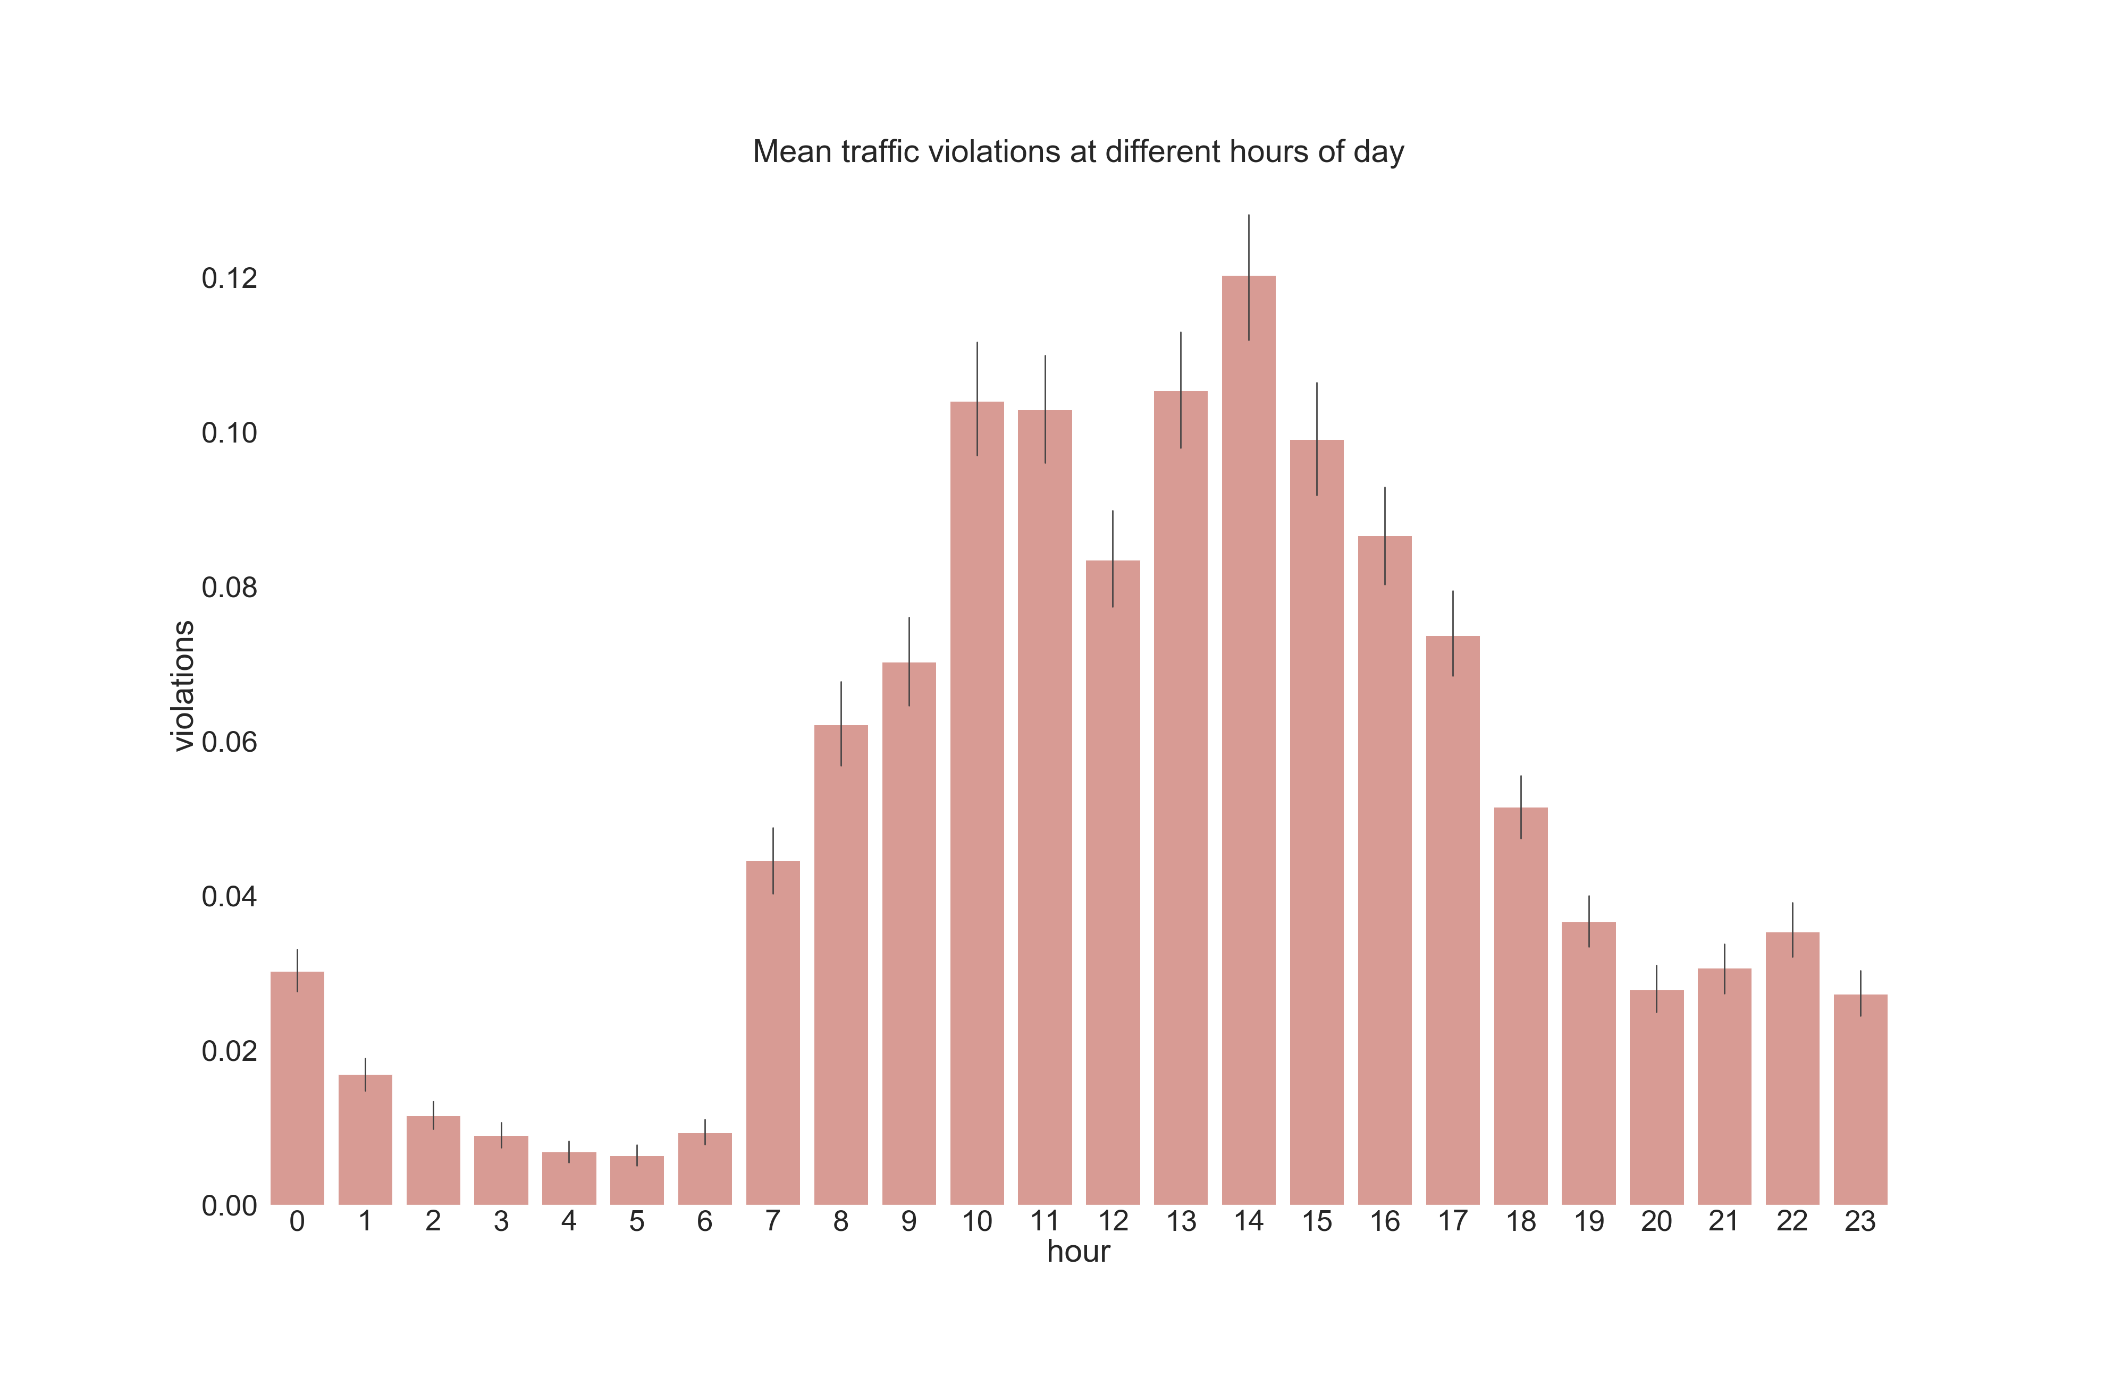
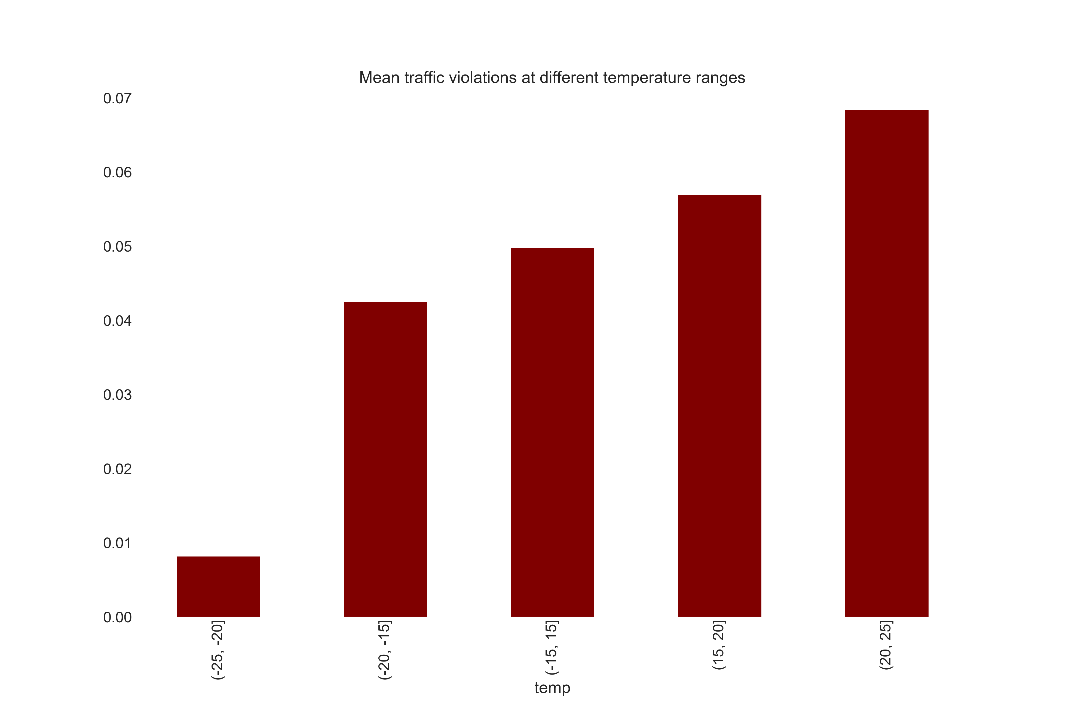
Traffic behavior dependence on
location, time and weather
Karl Marti Toots, Herman Klas Ratas
Motivation
Data
Traffic constitutes a major part of our societal routine. Traffic is governed and regulated by traffic laws for travel safety and efficiency for everyone. But with the determination of rules also come the events of breaking them. Violations and accidents in traffic are commonplace events in high population density areas like towns and cities. The violations are usually associated with bringing danger to other traffic users. It is the task of the law enforcement to catch and react to these violations in order to ensure the safety of traffic users. Tartu is the second largest city in Estonia and traffic violations occur there every day. Knowing more about where, when and in what conditions the violations occur the most could prove useful information to its citizens.
Open data about traffic violations was retrieved from the Estonian Police and Border Guard Board and weather data from the observations made with the equipment of University of Tartu, Institute of Physics, Laboratory of Environmental Physics. The locational traffic violations data is from a time period of 01.01.2012 to 11.12.2019 and were filtered by coordinates inside a 8 km x 9 km area. The weather measurements data is recorded every 5 minutes for the city of Tartu.
43 000 traffic violation entries
490 000 weather measurements entries
Results
1379
Narva road by Maxima grocery store. Picture: Google Maps
2467
Võidu bridge in the city center. Picture: https://et.wikipedia.org/wiki/Fail:Tartu_V%C3%B5idu_sild_2011.JPG
2015
1800
3482
1736
Junction of Turu and Sõbra street.
Picture: Google Maps
Roundabout at the end of Riia street. Picture: https://www.tartu.ee/en/node/7548
Heatmap of traffic violations in the city of Tartu in 2012-2019
Conclusions
Legs are freezing, not enough strength to push the pedal
Lunchtime?
Mean traffic violations at different hours of day
No significant relation between traffic violation amount and dry and rainy weather
Less violations during weekends
On average, there were more traffic violations with heavy rain than with light rain
Violation hotspots varied during the years under observation
Low correlation between weather and violations for predictive models
More violations during higher illuminance
Mean traffic violations at different temperatures
Amount of violations
Amount of violations
Hour of day
Temperature ºC
Source code:
https://github.com/karlmartitoots/DataScienceProject

